Slide 1
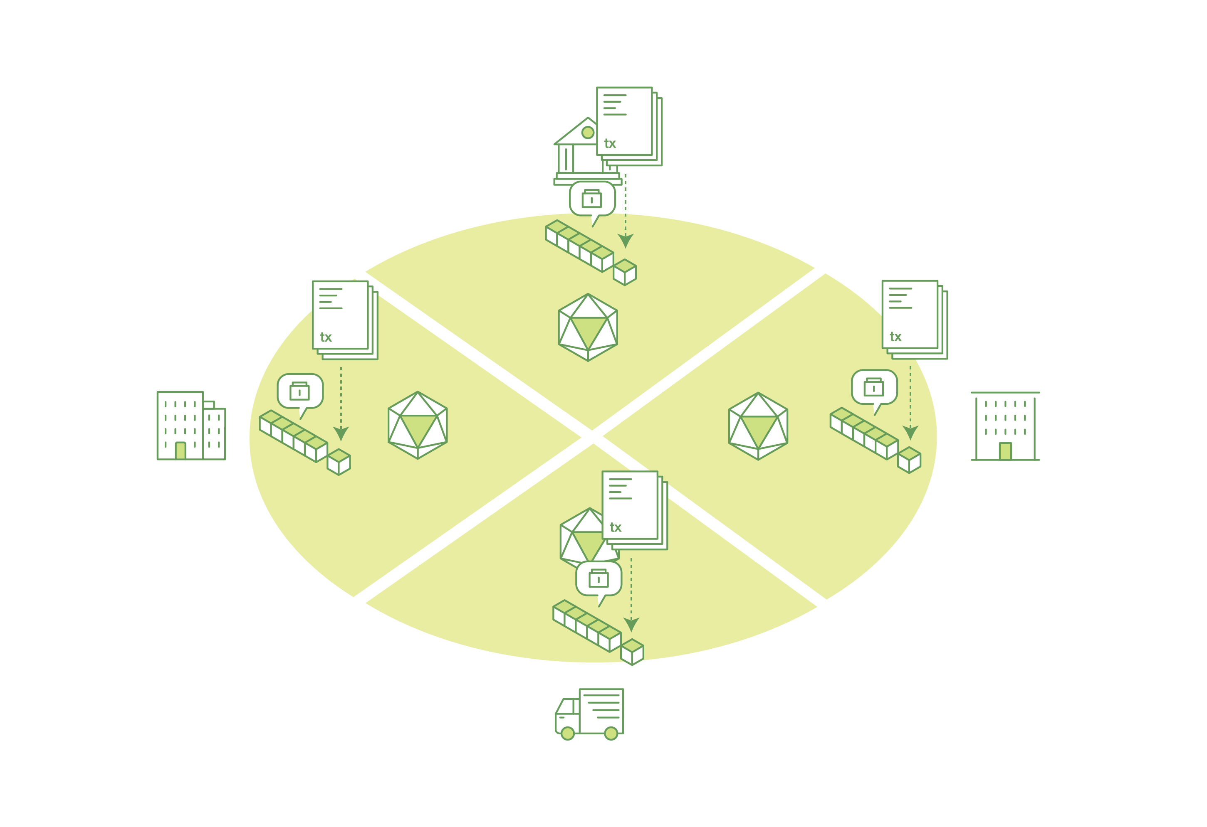
Block-chain
See http://hyperledger-fabric.readthedocs.io/en/latest/blockchain.html

Slide 2
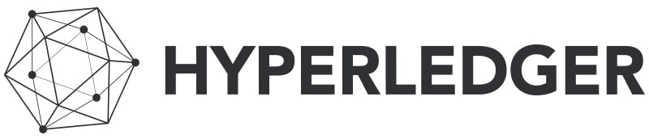
A blockchain network is a distributed ledger that records all the transactions that take place of the network.
For this discussion we will leave Bitcoins and focus on an open source implementation called Fabric. Source code is found in Github under hyperledger/Fabric which was created recently in a hackathon.

Slide 3
A blockchain ledger is often described as decentralized because it is replicated across many network participants, each of whom collaborate in its maintenance.

Slide 4
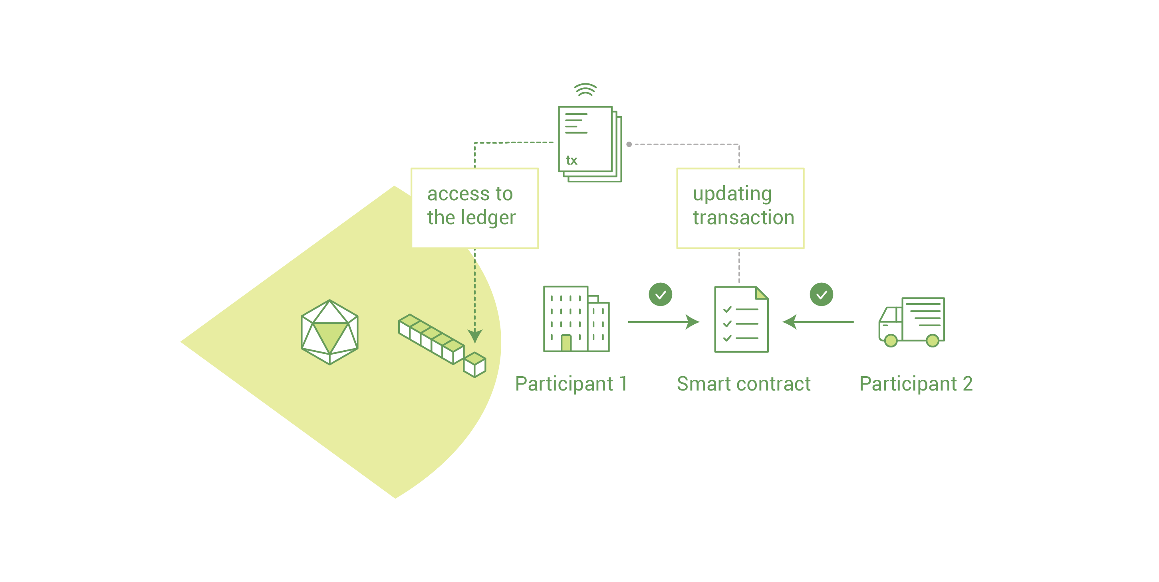
To support the consistent update of information – and to enable a whole host of ledger functions (transacting, querying, etc) – a blockchain network uses smart contracts to provide controlled access to the ledger

Slide 5
Contracts are actually “chaincode” and written in Go and compiled into a blockchain.
This code is the read and write of information into a blockchain:
// Invoke is called per transaction on the chaincode. Each transaction is
// either a 'get' or a 'set' on the asset created by Init function. The Set
// method may create a new asset by specifying a new key-value pair.
func (t *SimpleAsset) Invoke(stub shim.ChaincodeStubInterface) peer.Response {
// Extract the function and args from the transaction proposal
fn, args := stub.GetFunctionAndParameters()
var result string
var err error
if fn == "set" {
result, err = set(stub, args)
} else {
result, err = get(stub, args)
}
if err != nil {
return shim.Error(err.Error())
}
// Return the result as success payload
return shim.Success([]byte(result))
}

Slide 6
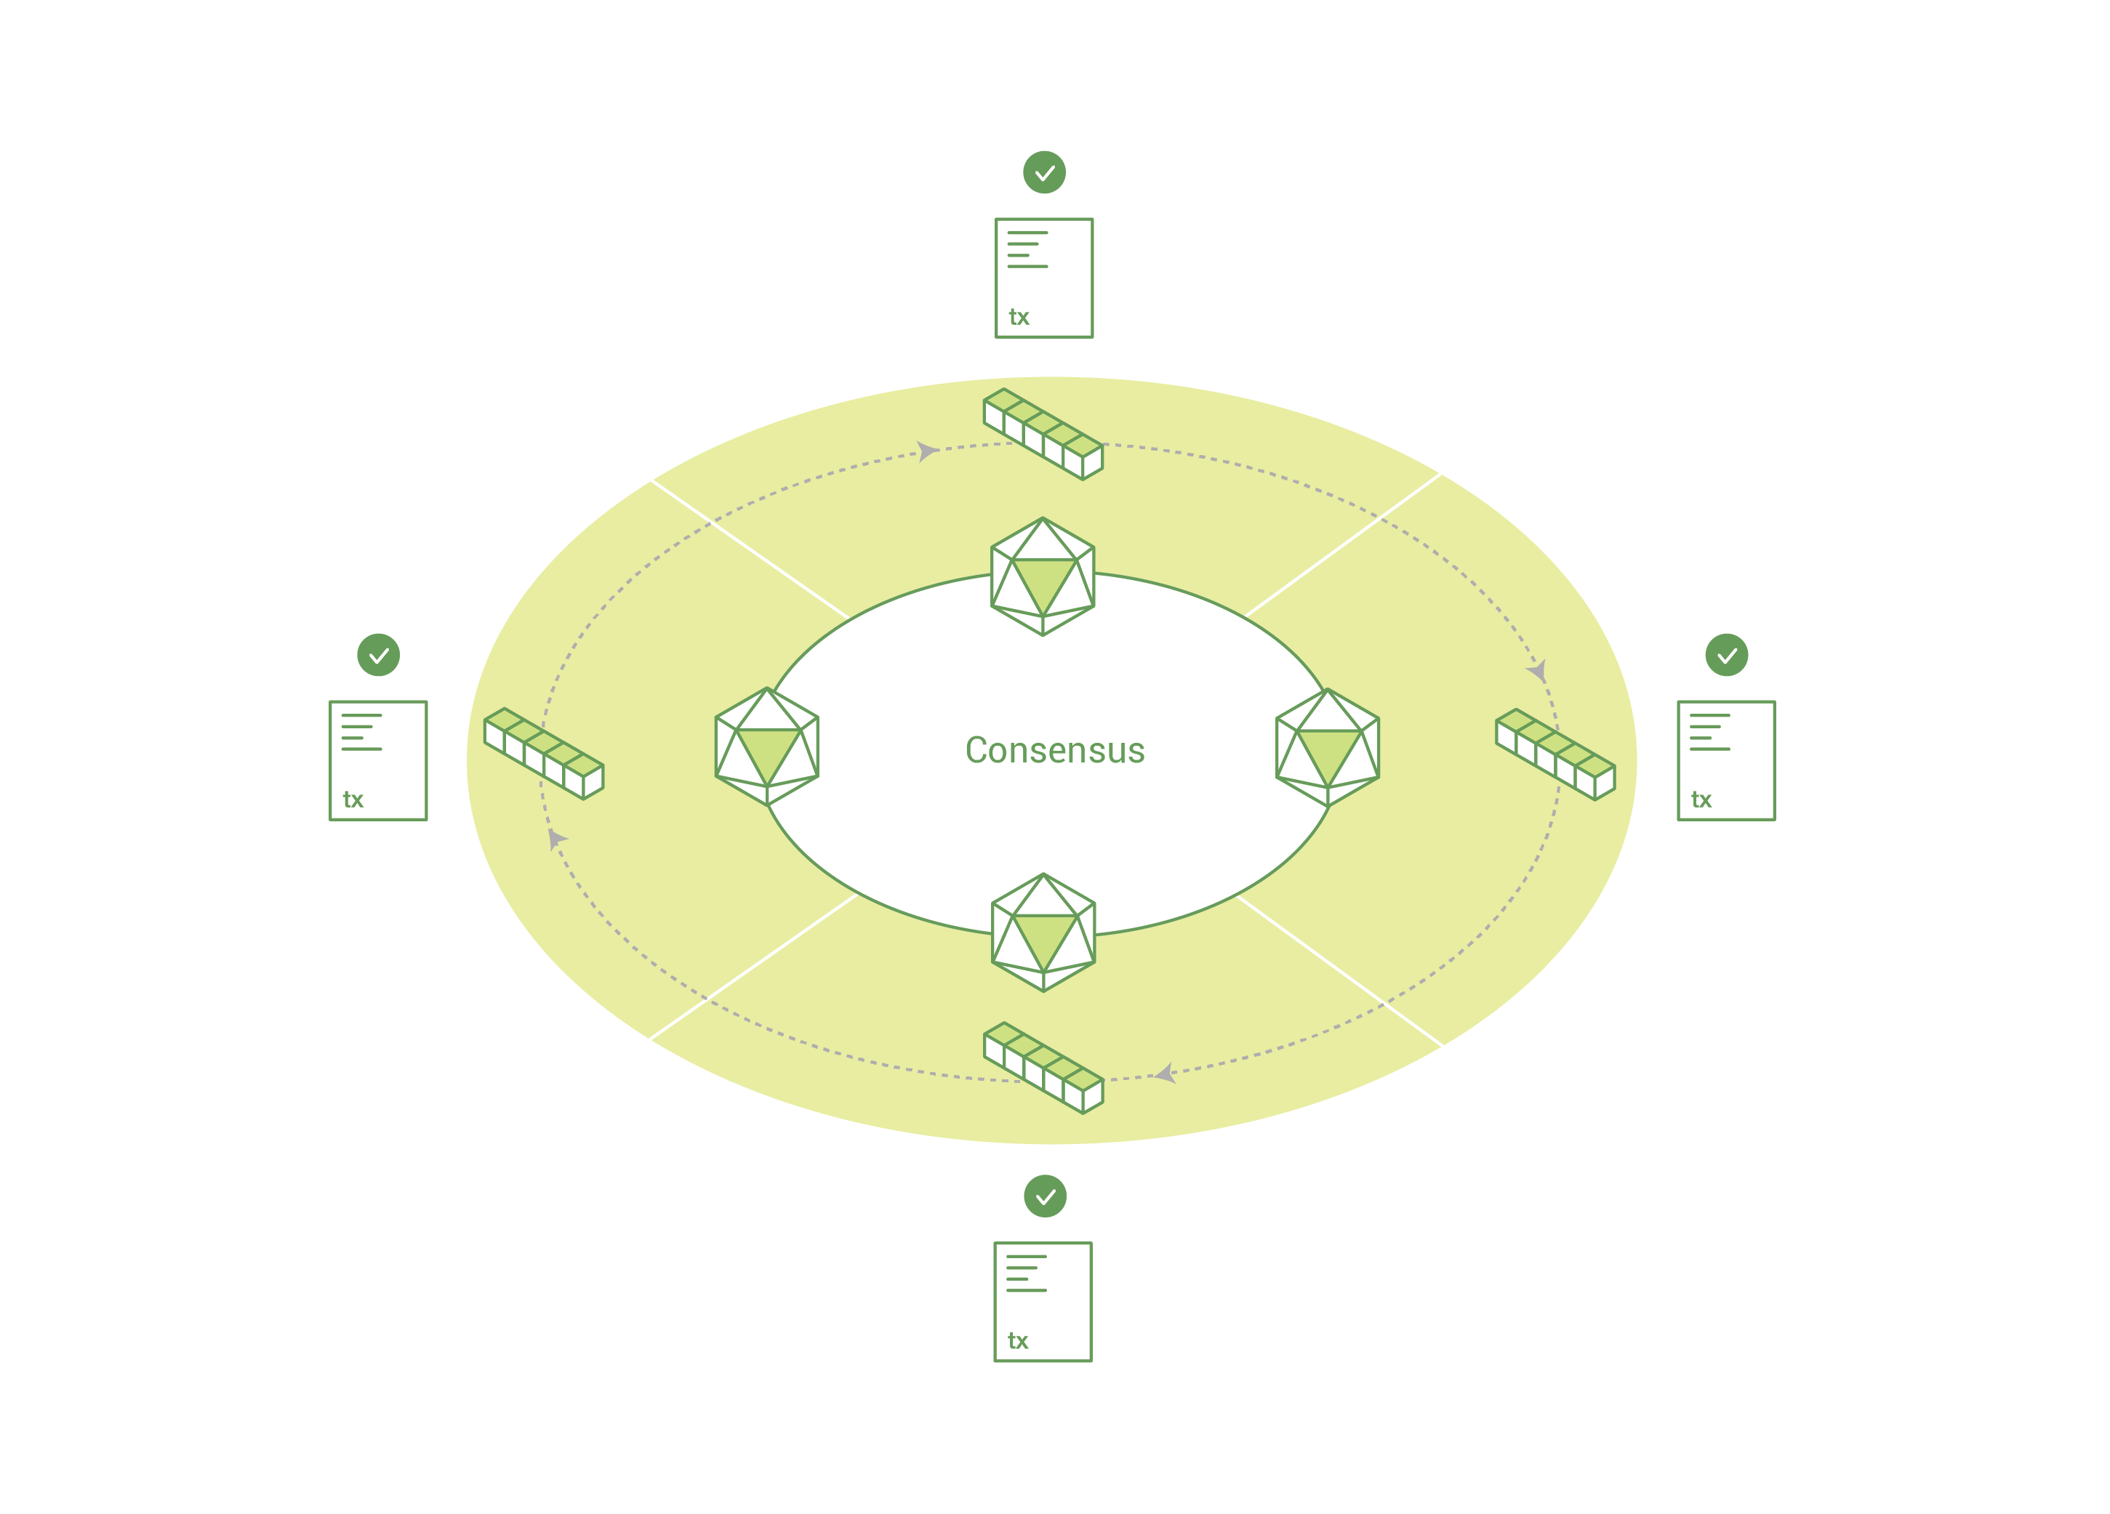
The process of keeping the ledger transactions synchronized across the network – to ensure that ledgers only update when transactions are approved by the appropriate participants, and that when ledgers do update, they update with the same transactions in the same order – is called consensus.
Note: There is no mining and no POW

Slide 7
Fabric does not use POW but instead a Membership Service Provider (MSP) which is a version of central authority. Without the POW the Byzantine Fault Tolerance issue surfaces. This is a roadmap item for Fabric.
See https://en.wikipedia.org/wiki/Byzantine_fault_tolerance
Fabric allows private, that is not shared, transactions between peers. This allows using the ledger for biz transactions that should not be shared. For example purchase agreements.

Slide 8
Switching to Bitcoin
Source is open.
See https://github.com/bitcoin/bitcoin
The original paper: https://bitcoincore.org/bitcoin.pdf

Slide 9

Questions?

